Slide 1

Neuromorphic engineering: computational neuroengineering module
Mazzoni@Bionics 2025-2026

Slide 2

Neuronal Models

Slide 3
Introducing resting potential: the LEAKY integrate and fire neuron
Spike
Threshold potential
Excitatory input
Reset
Excitatory input
Comes back to resting
Excitatory input
Inhibitory input
Comes back to resting
Membrane
potential
Time

Slide 4
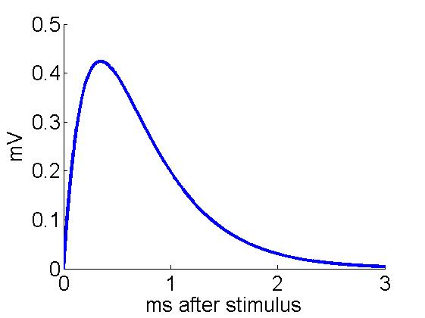
Leaky integrate-and-fire neuron
Only Excitatory and Inhibitory
synapses
Subthreshold:
Synaptic dynamics:
J
τr
τd
If
a spike is emitted
Vk drops to Vres
the neuron can not fire for a time τref
S
Other possibilities: NMDA synapses

Slide 5

Leaky integrate-and-fire neuron
Only Excitatory and Inhibitory
synapses
Subthreshold:
Synaptic dynamics:
$τ_{m}$= relaxation time of membrane potential (usually 20 ms or so, depends on the size of the soma)
Reset potential is set at 0 mV
$V_{A}$ indicates AMPA (excitatory) post-synaptic potentials (PSP)
$V_{G}$ indicates GABA (inhibitory) post-synaptic potentials (PSP)
J
τr
τd
If
a spike is emitted
Vk drops to Vres
the neuron can not fire for a time τref
S
Other possibilities: NMDA synapses

Slide 6

Leaky integrate-and-fire neuron
$τ_{r}$ indicates rise time of the PSP (1-5 ms usually) due to channel opening
$τ_{d}$indicates decay time of the PSP (3-10 ms usually) due to channel closing
$S_{k}^{stim}$ is 0 except when the neuron is receiving an input
$J_{k}^{stim}$ is the strength of the input
Only Excitatory and Inhibitory
synapses
Subthreshold:
Synaptic dynamics:
J
τr
τd
If
a spike is emitted
Vk drops to Vres
the neuron can not fire for a time τref
S
Other possibilities: NMDA synapses

Slide 7
Leaky integrate-and-fire neuron
Only Excitatory and Inhibitory
synapses
Subthreshold:
The solution of the coupled differential equation is a difference of exponential following the onset of each stimulus, with amplitude J.
Synaptic dynamics:
J
τr
τd
If
a spike is emitted
Vk drops to Vres
the neuron can not fire for a time τref
S
Other possibilities: NMDA synapses

Slide 8
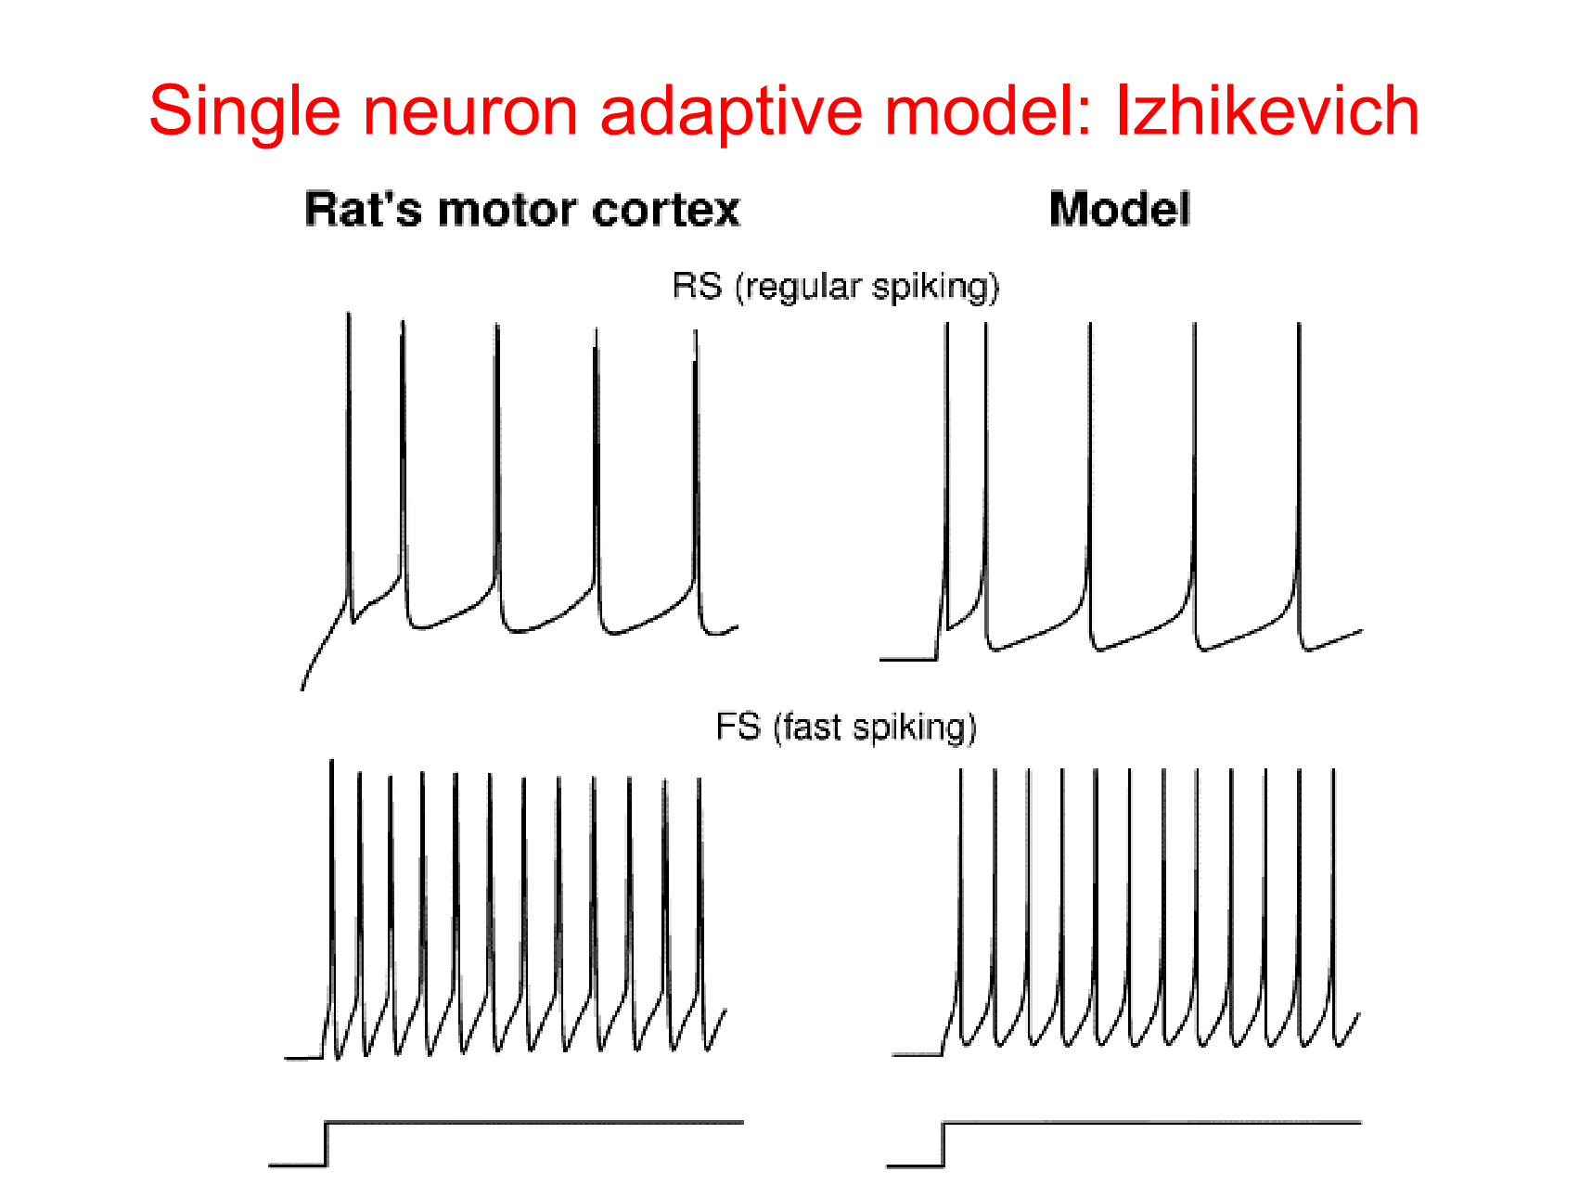

Slide 9
Adaptation: the input is constant but the inter-spike interval increases

Slide 10
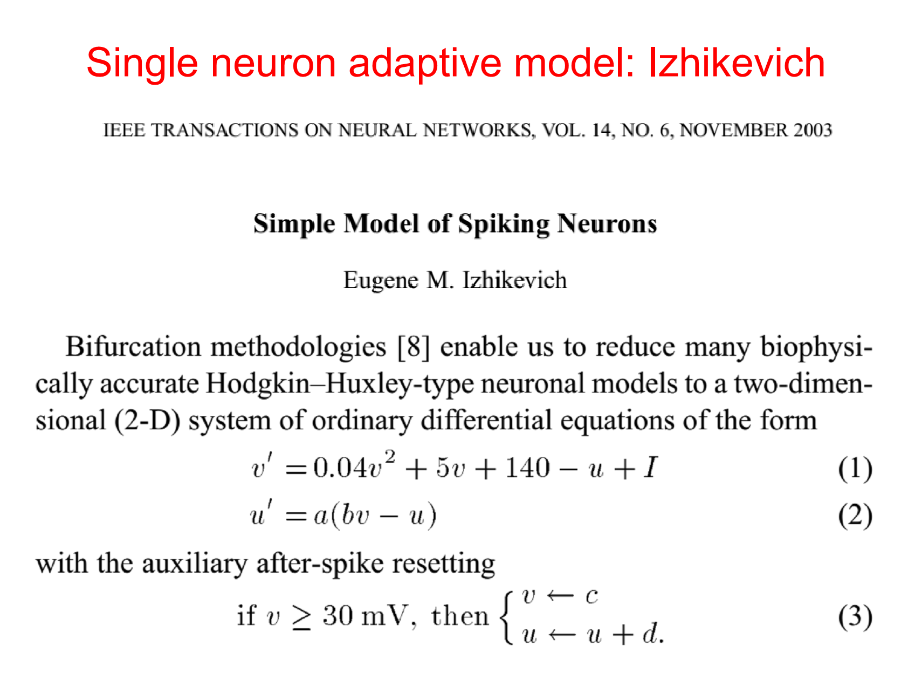

Slide 11
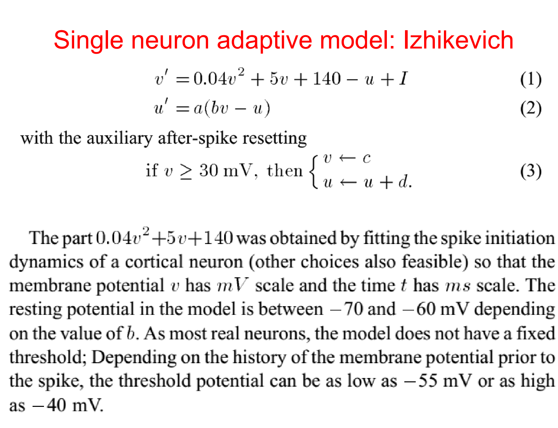

Slide 12
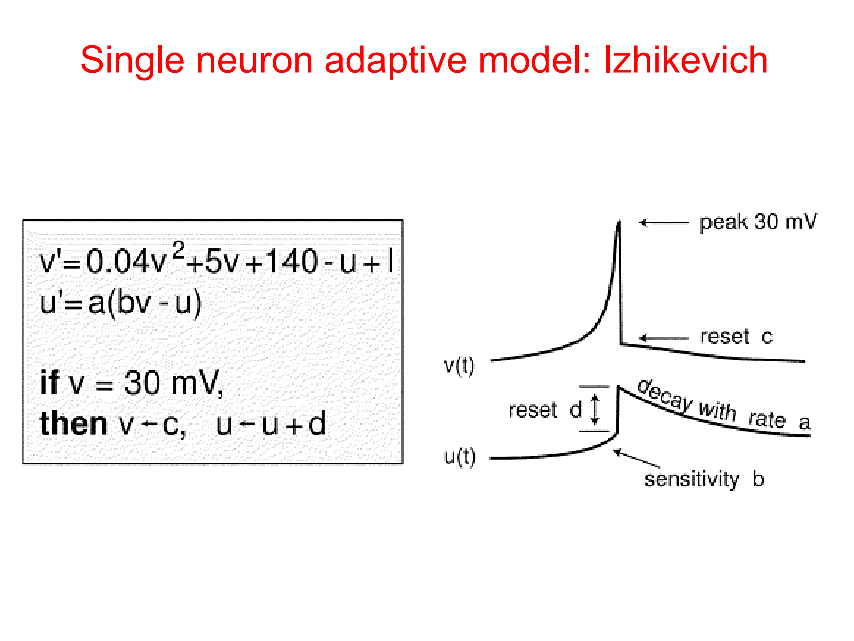

Slide 13
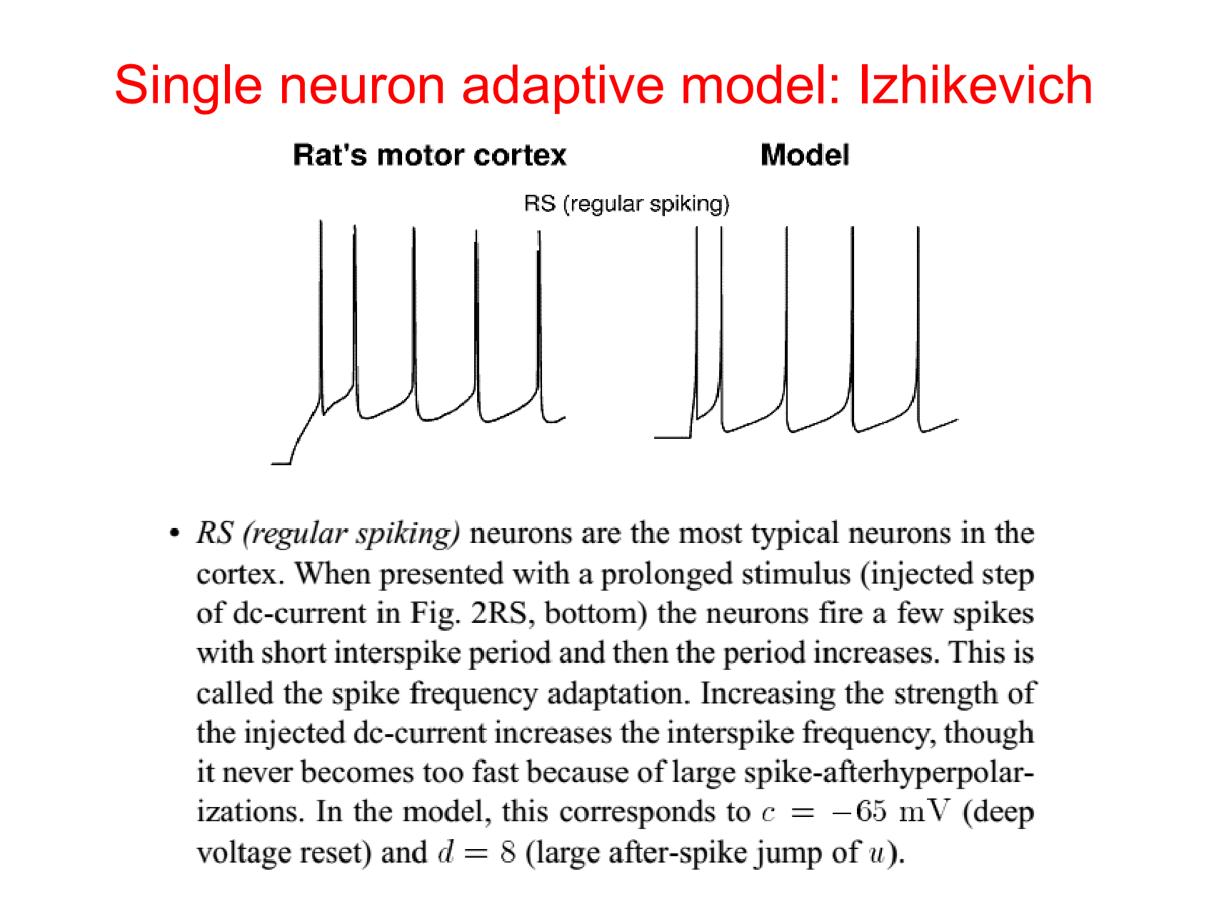

Slide 14
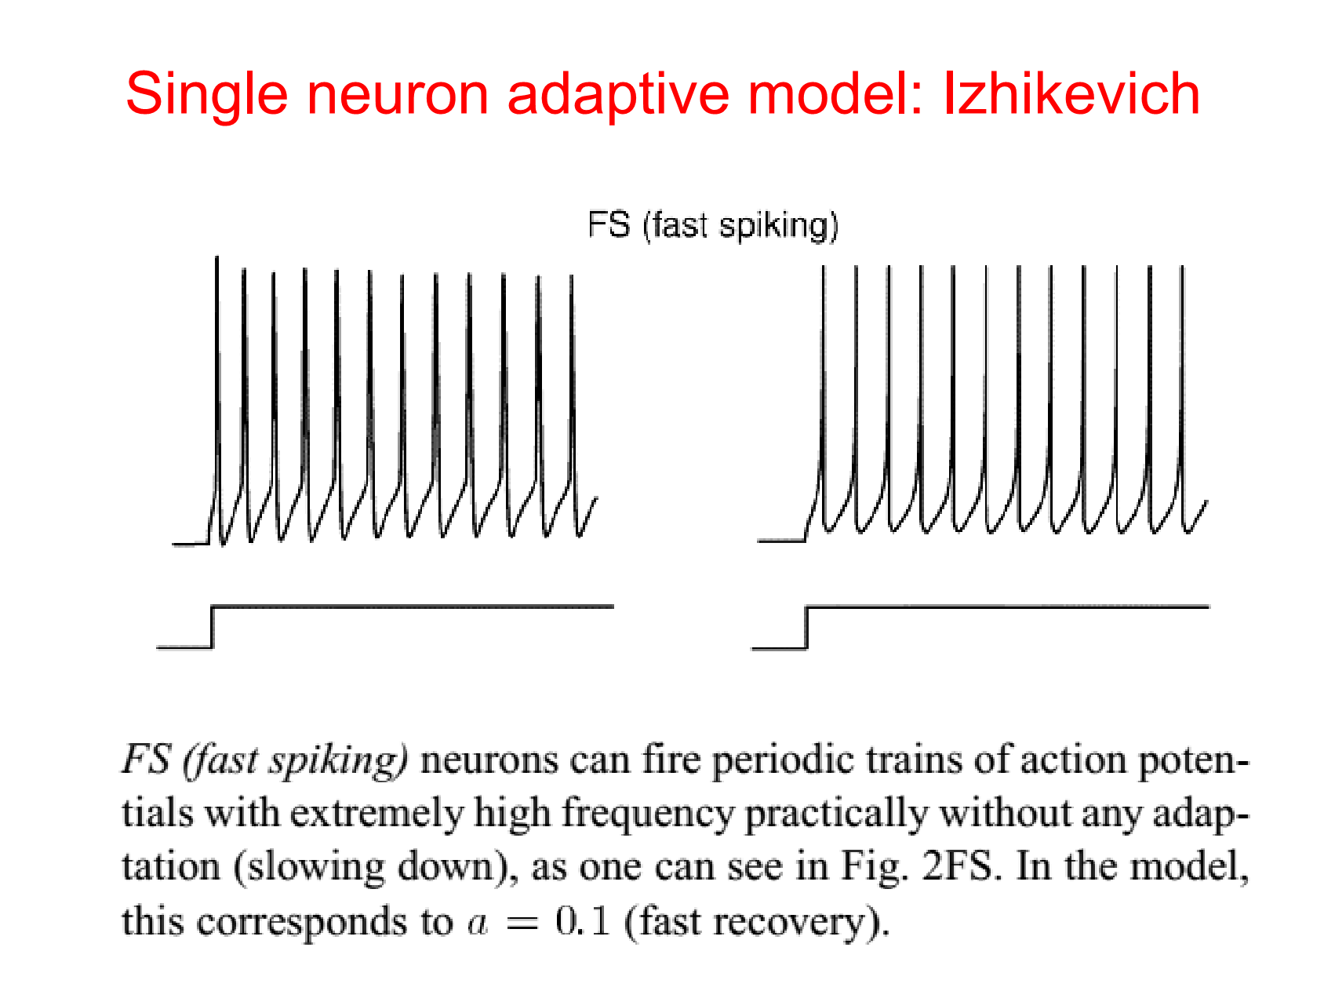

Slide 15
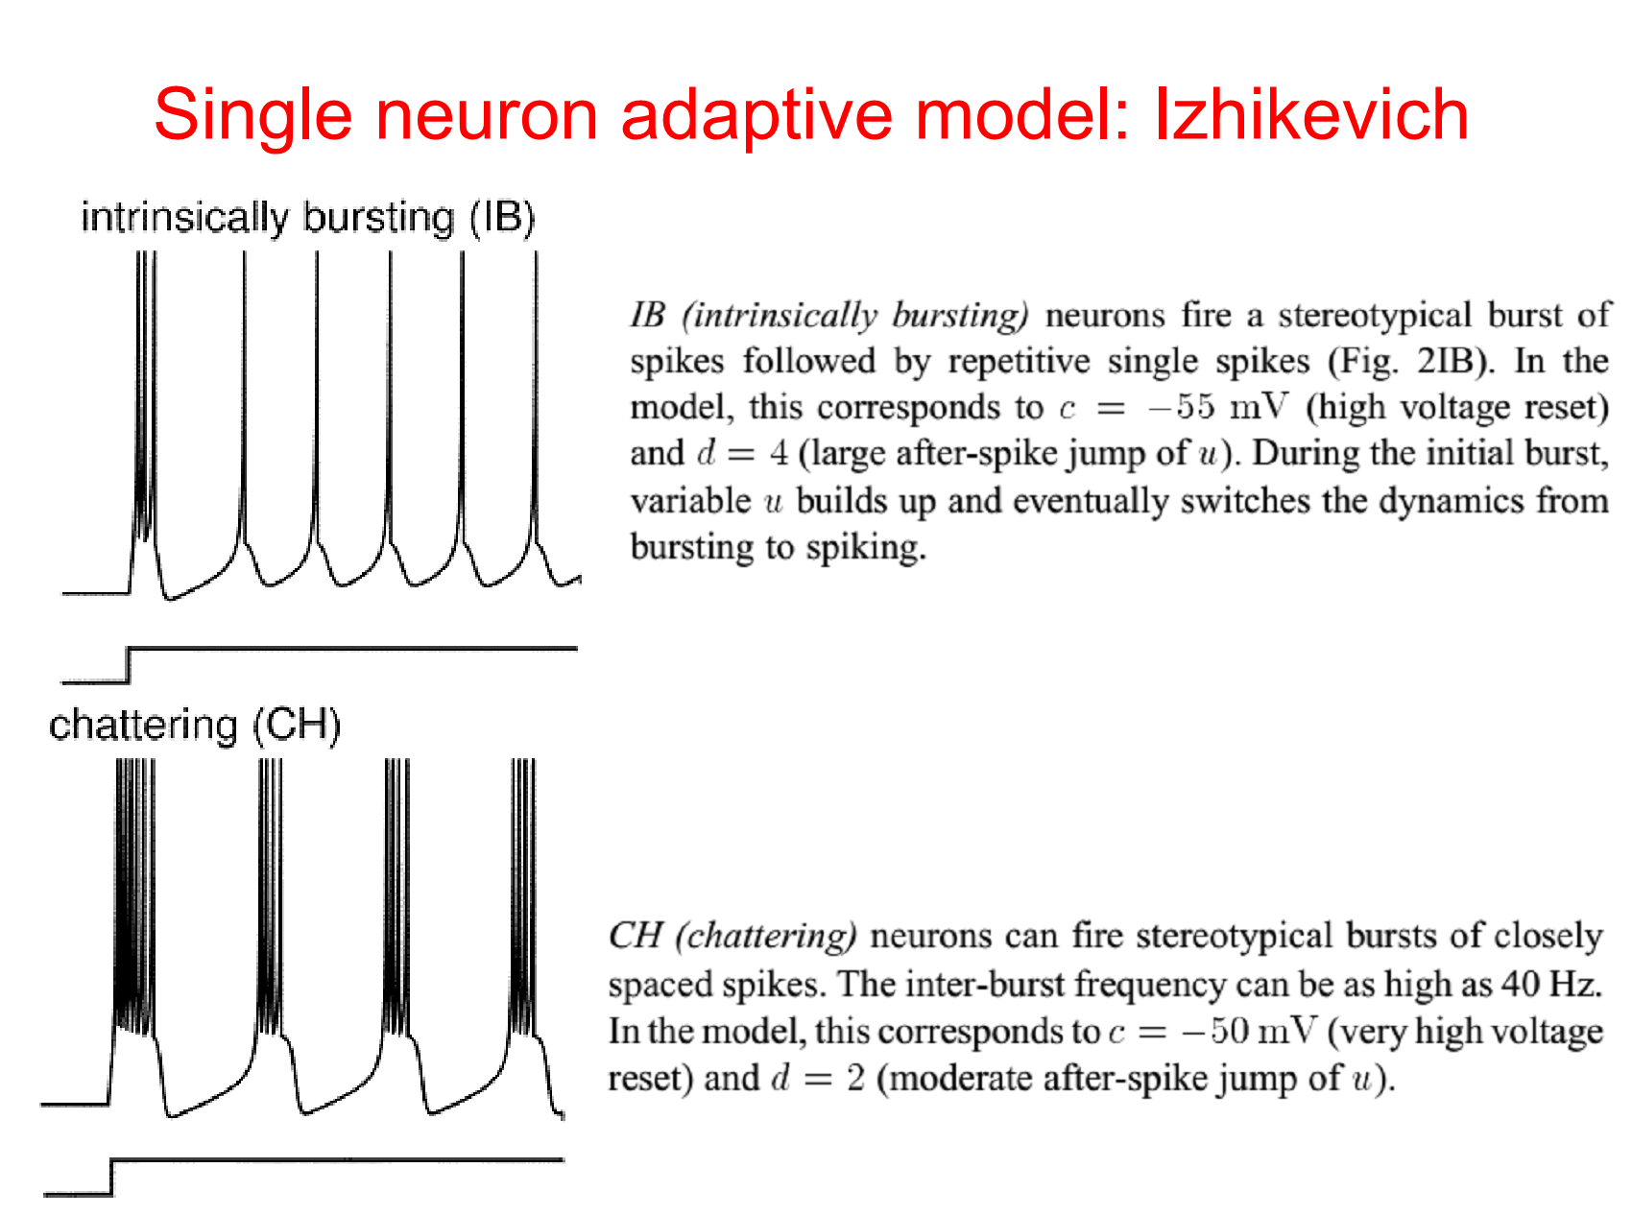

Slide 16
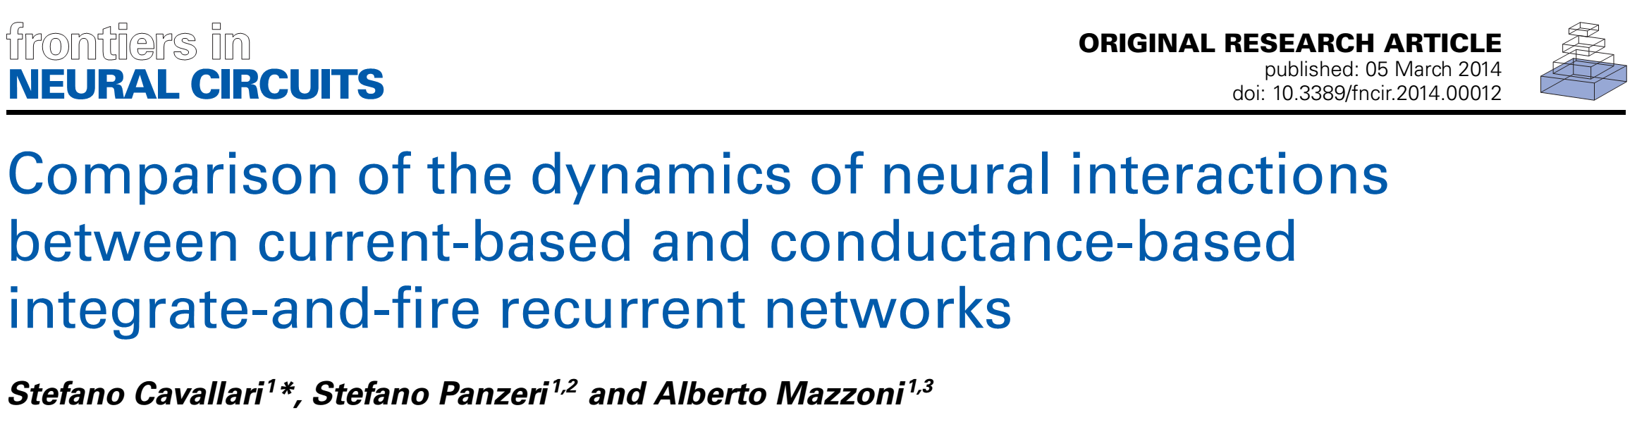
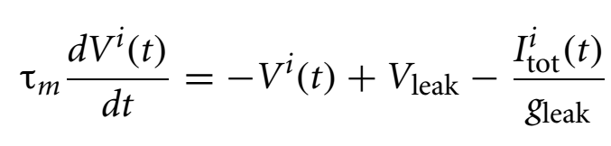
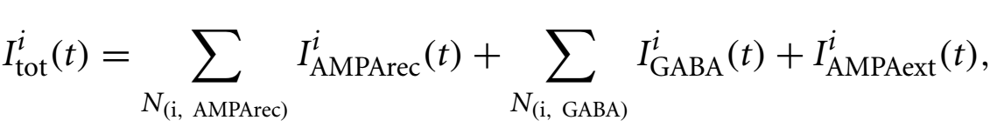

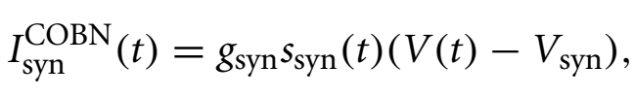
Conductance based

Slide 17
REVERSAL POTENTIAL (from Wikipedia) In a biological membrane, the reversal potential (also known as the Nernst potential) of an ion is the membrane potential at which there is no net (overall) flow of that particular ion from one side of the membrane to the other. In the case of post-synaptic neurons, the reversal potential is the membrane potential at which a given neurotransmitter causes no net current flow of ions through that neurotransmitter receptor's ion channel
Conductance based

Slide 18
Key Idea:
in CURRENT_BASED models the PSP does NOT depend on V(t)
in CONDUCTANCE_BASED models the PSP DOES depend on V(t)
Conductance based

Slide 19

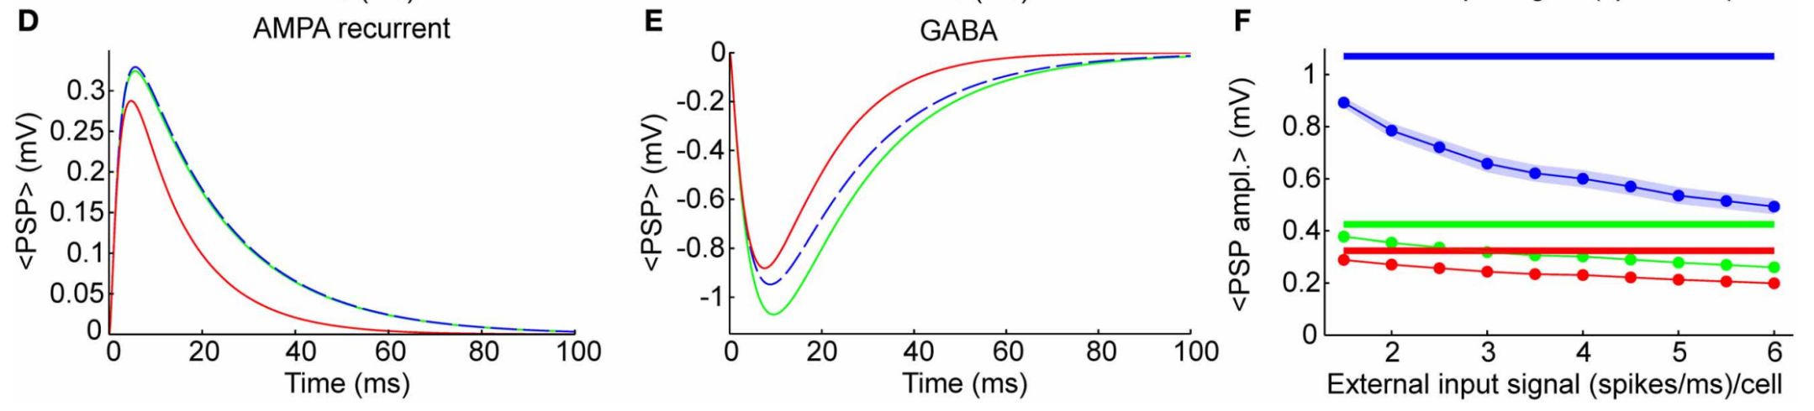
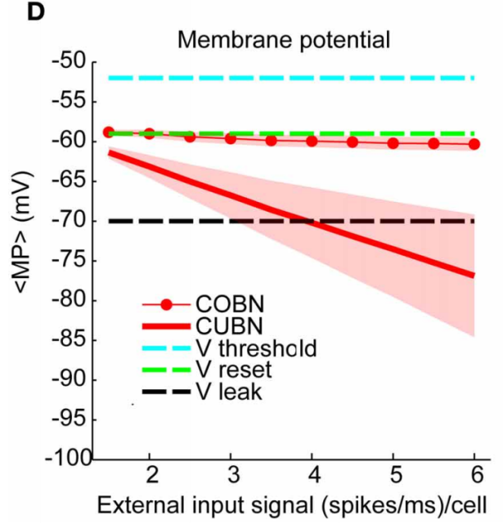
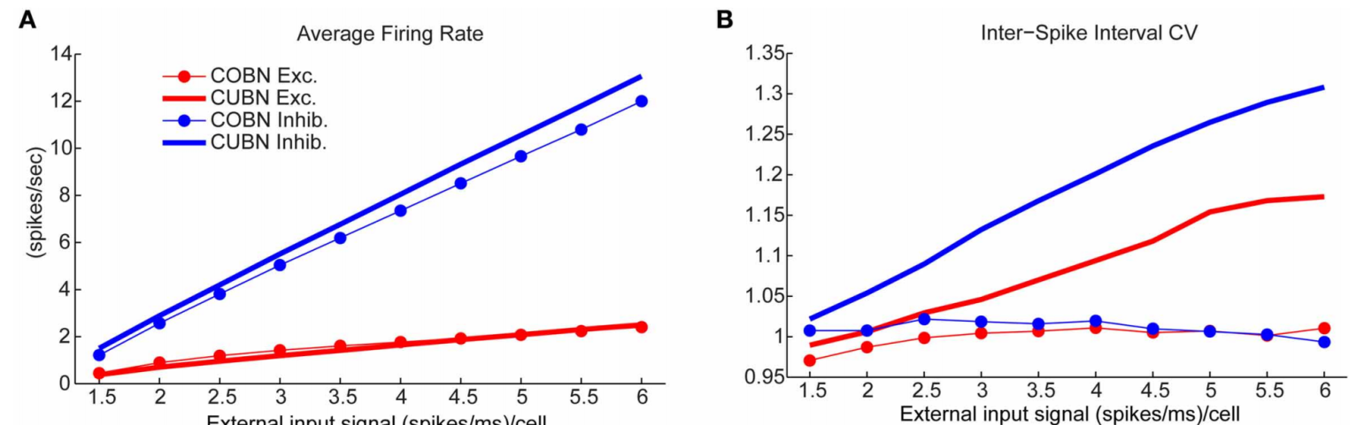

Slide 20
in CURRENT_BASED models V(t) can go arbitrarily low if inhibition is dominant (like here)
This does not happen in CONDUCTANCE BASED models, as inhibitory PSP’s amplitude decreases for low V(t)

Slide 21
Firing rate is similar in the two models
but
The coefficient of variation (CV) is much larger in CURRENT_BASED models – while for CONDUCTANCE_BASED is always 1 (as observed experimentally).

Slide 22
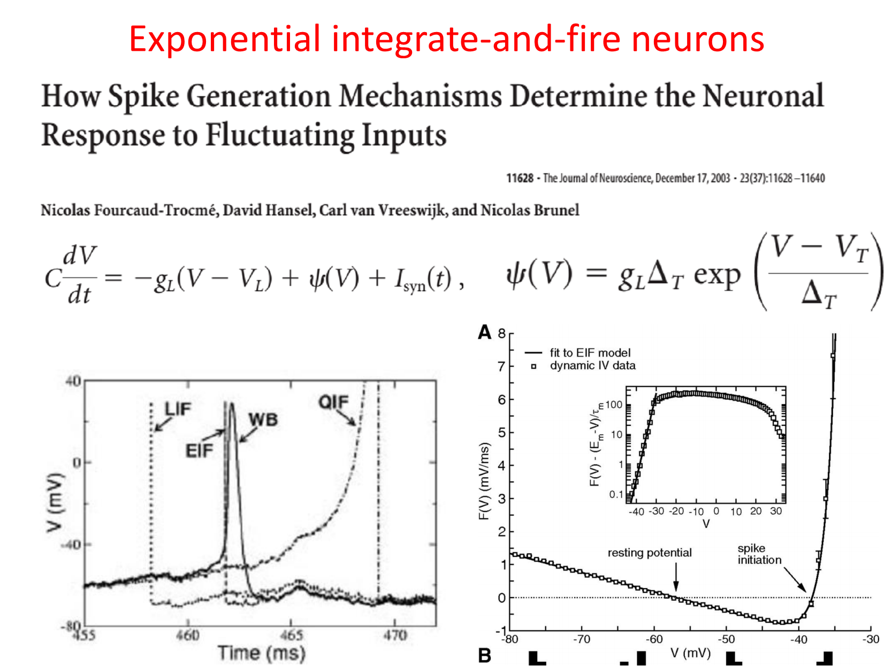

Slide 23
Note that now we have two thresholds: one for triggering the exponential rise (V_t in the equation in the left) and a second one (not explicited here) to cut the acton potential at 30 mV.

Slide 24
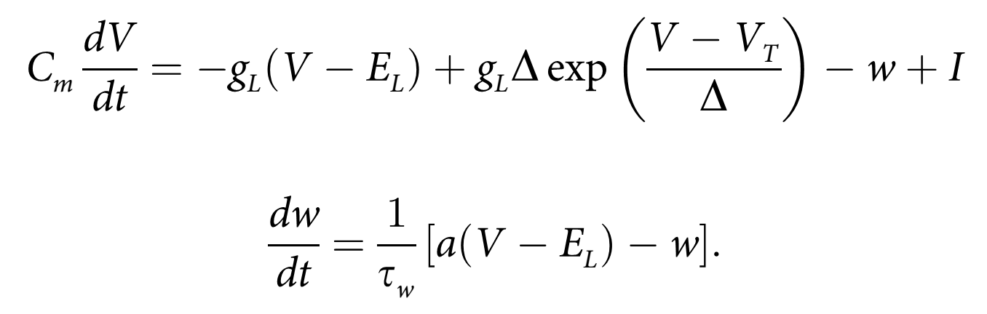
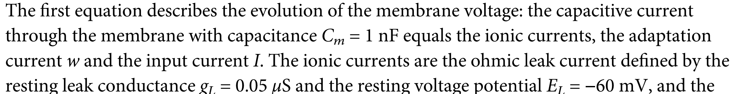
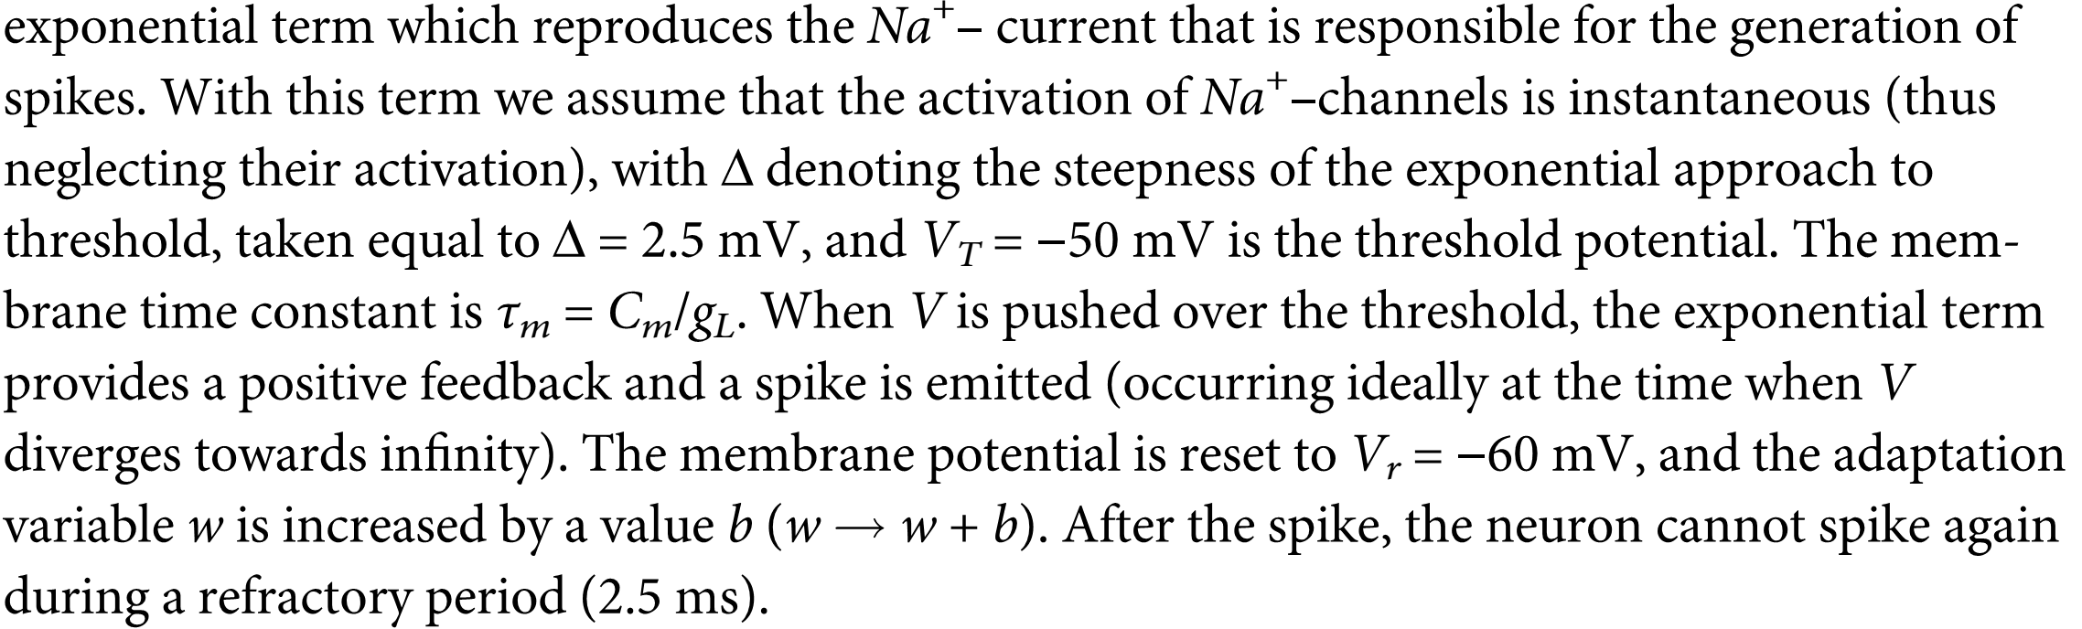
Adaptive exponential integrate-and-fire neuron

Slide 25
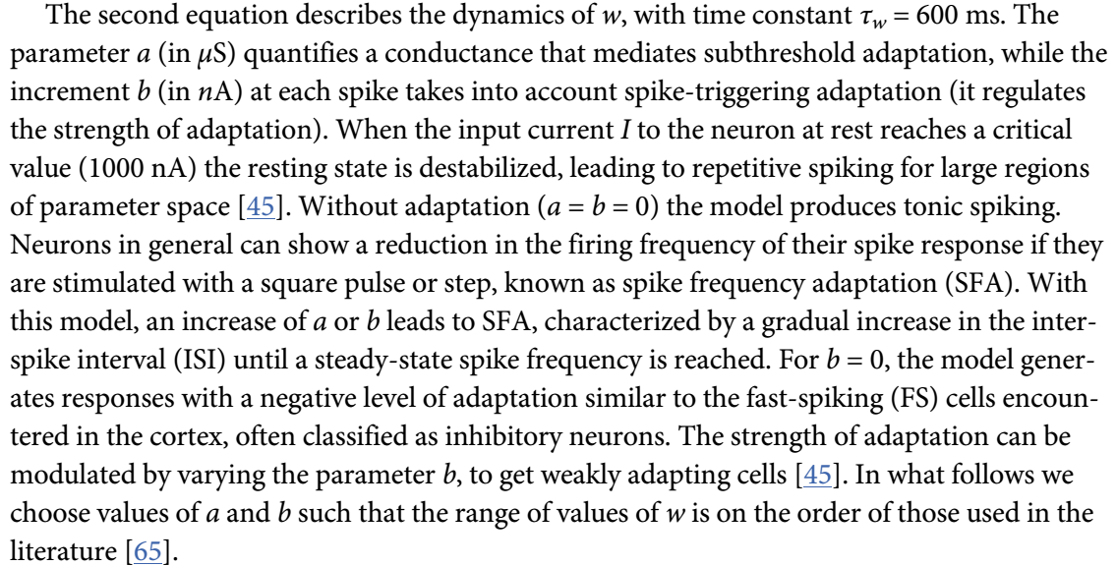
Adaptive exponential integrate-and-fire neuron

Slide 26
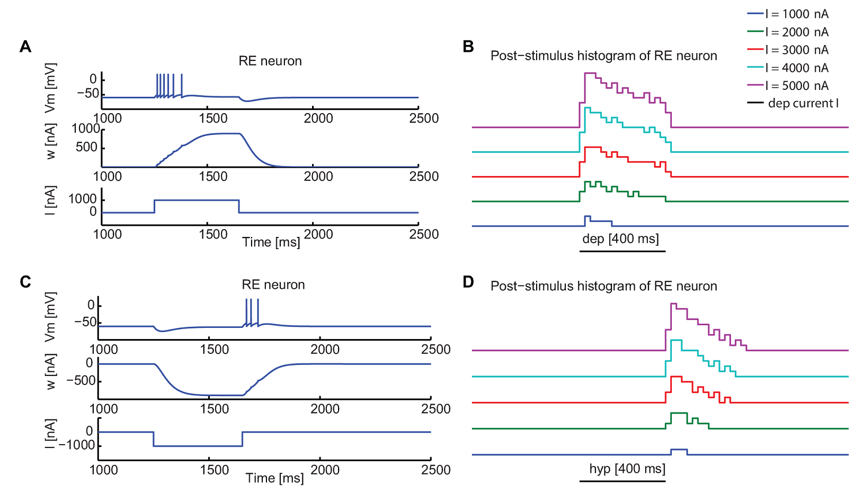
Adaptive exponential integrate-and-fire neuron

Slide 27
Adaptive exponential integrate-and-fire neuron
Firing for rebound from inhibition: if there’s a sustained inhibitory input the adaptation current becomes negative hence excitatory. When inhibition is released, the neuron emits a burst.

Slide 28
Increasing level of realism starting from LIF
Introducing ADAPTATION:
Izhikevich models (integrated)
Adaptive Exponential Integrate and Fire (plug-in)
Introducing ACTIVE CURRENTS:
HH models (the Nobel-prize squid)
EXC.
INH.
Introducing morphology:
NEURON
(and me)

Slide 29
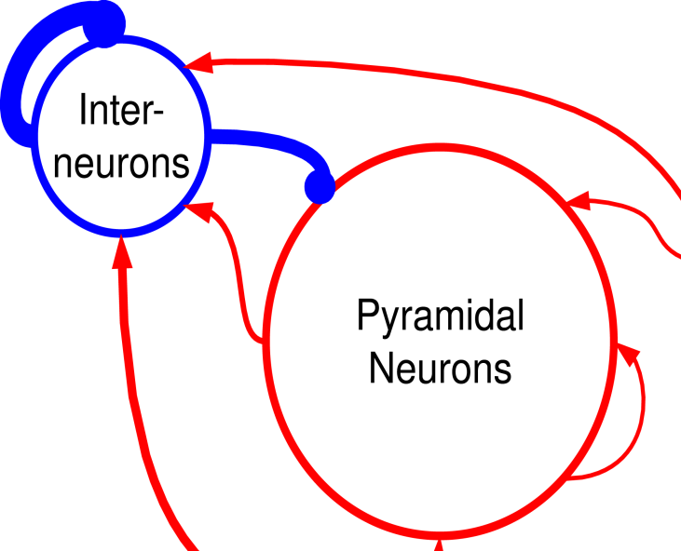
Introducing interaction:
Cortical recurring networks
4000 Excitatory neurons
1000 Inhibitory neurons
Sparse random connection (p=0.2)
Strong inhibition
.
Inhib.
Excitatory.

Slide 30
Introducing interaction:
Cortical recurring networks
4:1 excitatory/inhibitory ratio and strong inhibition combine to achieve excitatory/inhibitory
balance
4000 Excitatory neurons
1000 Inhibitory neurons
Sparse random connection (p=0.2)
Strong inhibition
.
Inhib.
Excitatory.

